Slide 1
Lesson 2
Principles of OOP
Objects and classes
Inheritance
Inheritance vs Composition
Interfaces
Multiple inheritance

Slide 2



What is an Object?
Software objects are software implementations of a real world object or idea.
Objects have 2 characteristics: State and Behavior
State Behavior
TV
brand, screensize, station
turn on, switch station, change brightness
Bicycle
current_gear, color, speed
switch gear, break
Dog
name, hungry, breed
bark, eat, sleep
08/21/00
Date
day, month, year
set month, compare

Slide 3
Software implementation of an object
public class BankAccount{
private long accountnr;
private double balance;
public BankAccount(){
balance=0;
}
public void setAccountnr(long acnr){
accountnr=acnr;
}
public long getAccountnr(){
return accountnr;
}
public double getBalance(){
return balance;
}
public void withDraw (double amount){
balance=balance-amount;
}
public void dePosit (double amount){
balance=balance+amount;
}
}
Class name
Attributes
(State)
Private attributes
constructor
Accessor functions for accountnr
Methods
(behavior)
Public method withDraw

Slide 4
public class BankAccount{
private long accountnr;
private double balance;
public BankAccount(){
balance=0;
}
public void setAccountnr(long acnr){
accountnr=acnr;
}
public long getAccountnr(){
return accountnr;
}
public double getBalance(){
return balance;
}
public void withDraw (double amount){
balance=balance-amount;
}
public void dePosit (double amount){
balance=balance+amount;
}
}
Abstraction is realized trough
encapsulation /information hiding:
Make an object a self-contained identity, and hide all the implementation details.
The user of the class only has to know the interface of the class
setAccountnr()
getAccountnr()
getBalance()
withDraw()
dePosit()
BankAccount

Slide 5
public class BankAccount{
private long accountnr;
private double balance;
public BankAccount(){
balance=0;
}
public void setAccountnr(long acnr){
accountnr=acnr;
}
public long getAccountnr(){
return accountnr;
}
public double getBalance(){
return balance;
}
public void withDraw (double amount){
balance=balance-amount;
}
public void dePosit (double amount){
balance=balance+amount;
}
}
public Definitions are available to everyone.
private Definitions are only available to methods of the class where the definitions are defined.
protected Like private, only an inheriting class can access protected definitions.
setAccountnr()
getAccountnr()
getBalance()
withDraw()
dePosit()
BankAccount

Slide 6
Using a class
‘Main’ method
public class application{
static public void main(String args[]){
// instantiate the class
BankAccount mybankaccount = new BankAccount();
// send messages to the instance of BankAccount
mybankaccount.setAccountnr(1234);
mybankaccount.dePosit (200);
}
}
Class
Instance
Sending messages

Slide 7

Class vs. Object
public class Customer{
private String name;
private String street;
private String city;
private String state;
private String zip;
private String social_security;
private String credit_card_number;
//... other methods
}
Class is a model of an abstraction and has no state changing over time.
Type of the instances of the class.
Object has a state that may change over time
Instance of a class.
Name = John Boole
street = 1000N, 4th Street
city= Fairfield
state=IA
zip= 52557
social_security= 2341-45-9988
credit_card_number=2980-3452-3451-2233

Slide 8
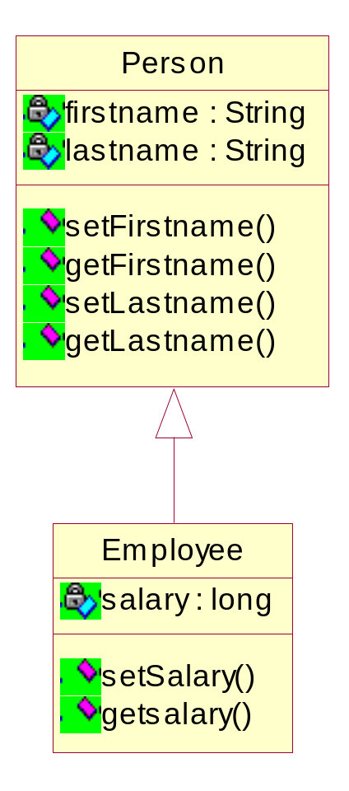
Inheritance
Represents a relationship between a general and a specific class
‘is-a’
relationship
Superclass
Base class
Subclass
Derived class
Employee inherits all attributes and methods from Person

Slide 9
Inheritance example
public class Person{
private String firstname;
private String lastname;
public void setFirstname(String name){
firstname=name;
}
public String getFirstname(){
return firstname;
}
public void setLastname(String name){
lastname=name;
}
public String getlastname(){
return lastname;
}
}
public class Employee extends Person {
private long salary;
public void setSalary(long amount){
salary=amount;
}
public String getSalary(){
return salary;
}
}

Slide 10
Inheritance example
public class application{
static public void main(String args[]){
Person myperson = new Person();
myperson.setFirstname("John");
Employee myemployee = new Employee();
myemployee.setFirstname("Frank");
myemployee.setLastname("Johnson");
myemployee.setSalary(6000);
}
}

Slide 11
Overriding a method
The subclass can change inherited behavior of the superclass by overriding methods.
To override an inherited method, you must declare the method in the subclass in exactly the same manner as the superclass method

Slide 12
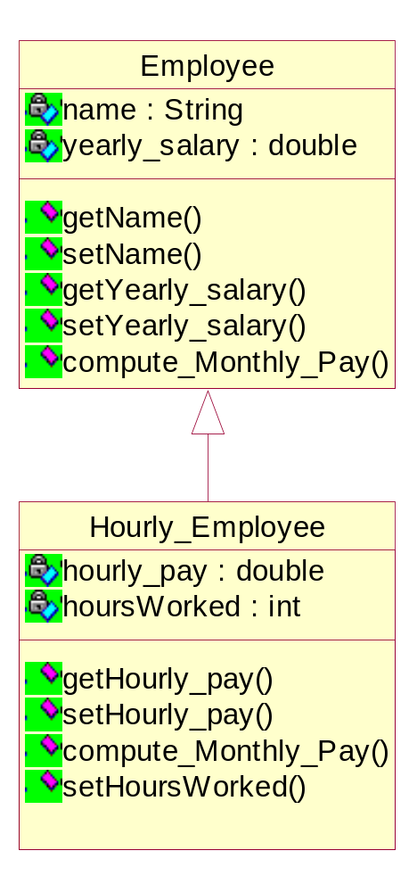
Example
public class Employee {
private String name;
private double yearly_salary;
// accessor functions for name and yearly_salary
//are not shown here
public double compute_Monthly_Pay(){
return yearly_salary/12;
}
}
public class Hourly_Employee extends Employee{
private double hourly_pay;
private int hoursWorked;
// accessor functions for hourly_pay and hoursWorked
//are not shown here
public double compute_Monthly_Pay(){
return hoursWorked * hourly_pay;
}
}
Overwrite method

Slide 13
public class Company{
Employee employee1 = new Employee();
employee1.setName("Mary");
employee1.setSalary(80000);
employee1.compute_Monthly_Pay();
Hourly_Employee employee2 = new Hourly_Employee();
employee2.setName("Sally");
employee2.setHourlyPay(80);
employee2.setHoursWorked(120);
employee2.compute_Monthly_Pay();
}
Inherited method
Call overwritten method of Hourly_Employee class

Slide 14
Advantages of inheritance?
Software Reusability
  Behavior is inherited from another class and does not have to be rewritten.
  This leads to extra reliability, as the code will have been tested previously. Each time the code is used the reliability will be tested.
Rapid prototyping
Information Hiding

Slide 15
Problems with inheritance
Object classes are not self-contained. They cannot be understood without reference to their super-classes. (Not well encapsulated)
Program Size: because subclasses inherit everything from its superclasses. Not a real problem!
Errors in the superclass ripple down to the subclasses.

Slide 16
Inheritance offers code reuse
When should we use inheritance?
Inheritance offers weak encapsulation and superclasses become fragile: Changes to the superclass can result in errors in subclasses or in code that uses the subclasses
Association also offers code reuse.

Slide 17
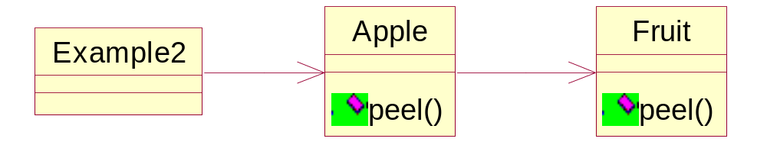
Code reuse via Association
public class Fruit {
…
}
public class Apple {
private Fruit fruit = new Fruit();
// Can now use All methods of Fruit
public int Method1() {
return fruit.doSomething();
}
}
Delegation: delegate the work to another method

Slide 18
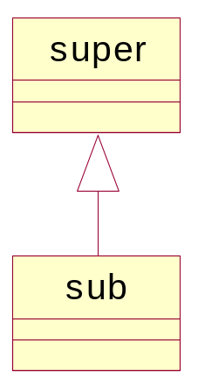
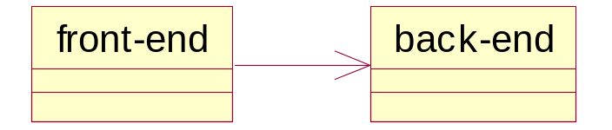
Inheritance versus Association
“is-a” versus “has-a”
It is easier to change the back-end class of association, than a superclass in inheritance. (Getting code reuse.)
It is easier to add new subclasses (inheritance) than it is to add new front-end classes (association), because inheritance comes with polymorphism.
Delegation has a (small)performance cost compared to inheritance.

Slide 19
Inheritance versus composition
Conclusion
Make sure inheritance models the ‘is-a’ relationship and that this ‘is-a’ relationship will be constant throughout the lifetime of the application.
Don't use inheritance just to get code reuse
If all you really want is to reuse code and there is no ‘is-a’ relationship in sight, use association.

Slide 20
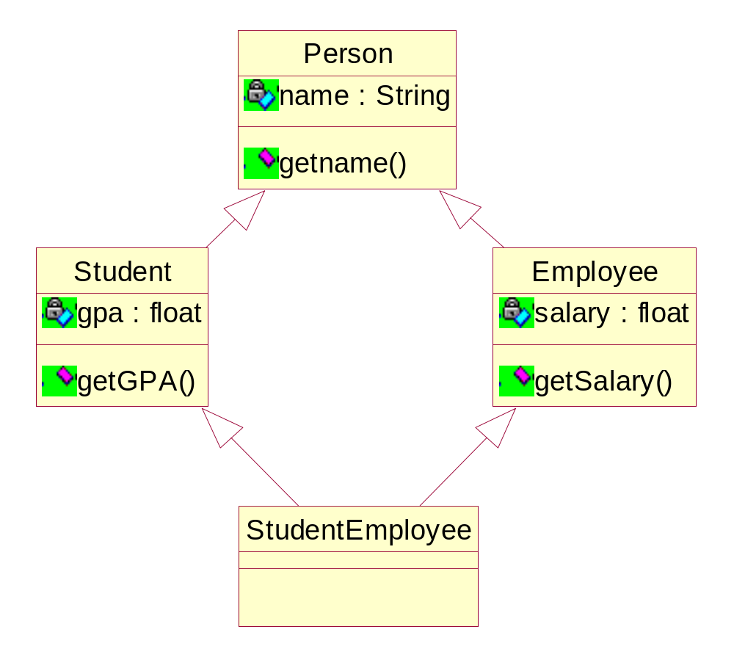
Multiple Inheritance
When a subclass inherits from 2 superclasses
Problem with multiple inheritance: diamond-shaped Multiple Inheritance

Slide 21
public class Person{
private String name;
public String getName(){
return name;
}
//... other methods
}
public class Student extends Person{
private float gpa;
public float getGPA(){
return gpa;
}
//... other methods
}
public class Employee extends Person{
private float salary;
public float getSalary(){
return salary;
}
//... other methods
}
public class StudentEmployee
extends Student, Employee{
//inherits both getGPA() and getSalary()
}
Illegal in Java
but legal in C++
How many names does a student-employee have? -> 2
If we access the name field, which copy of name is accessed?

Slide 22
Java does not support pure multiple inheritance.
Multiple Inheritance can be accomplished in java with Interfaces and Delegation.
Interfaces
An interface defines the protocol for certain behavior.
public interface IBankAccount{
public BankAccount();
public void setAccountnr(long acnr);
public long getAccountnr();
public double getBalance();
public void withDraw (double amount);
public void dePosit (double amount);
}
setAccountnr()
getAccountnr()
getBalance()
withDraw()
dePosit()
BankAccount

Slide 23
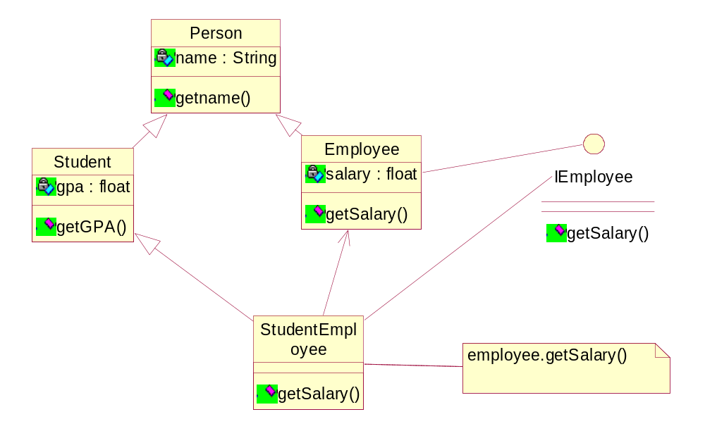

Slide 24
public class Person{
private String name;
public String getName(){
return name;
}
//... other methods
}
public class Student extends Person{
private float gpa;
public float getGPA(){
return gpa;
}
//... other methods
}
Public interface IEmployee{
public float getSalary();
}
public class Employee extends Person
implements IEmployee{
private float salary;
public float getSalary(){
return salary;
}
//... other methods
}
public class StudentEmployee extends Student
implements IEmployee{
//inherits getGPA()from Student
private Employee employeeimpl;
public StudentEmployee(){
employeeimpl = new Employee();
}
public float getSalary(){
return employeeimpl.getSalary(); //delegation
}
}

Slide 25
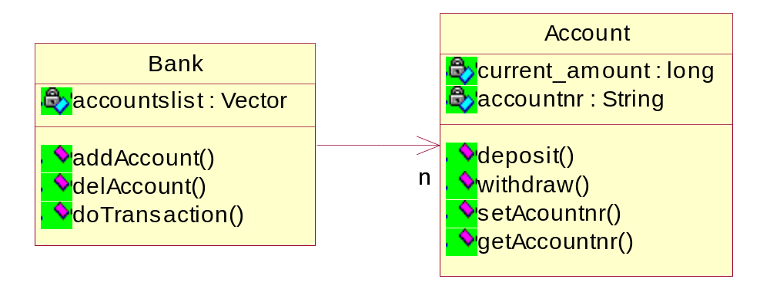
Example of objects sending messages to other objects
public class Account{
private double current_amount;
private String accountnr;
public void deposit(long amount){
current_amount+=amount;
}
public void withdraw(long amount){
current_amount-=amount;
}
public void setAccountnr(String anr){
accountnr=anr;
}
public String getAccountnr(){
return accountnr;
}
}

Slide 26
public class Bank{
private ArrayList accountslist;
public void addAccount(String accountnr){
Account account;
account = new Account();
account.setAccountnr(accountnr);
accountslist.add(account);
}
}
public void delAccount(String accountnr){
Account account;
for (int x=0; x<accountslist.size(); x++){
account=(Account)accountslist.get(x);
if (account.getAccountnr().equals(accountnr)){
accountslist.remove(account);
break;
}
}
}
public void doTransaction(String accountnr, String transactiontype, double amount){
Account account;
for (int x=0; x<accountslist.size(); x++){
account=(Account)accountslist.get(x);
if (account.getAccountnr().equals(accountnr)){
if (transactiontype.equals(“deposit”))
account.deposit(amount);
else
account.withdraw(amount);
break;
}
} //Ask – Why does the withdraw work?
} // How is this changing original ArrayList?
// Draw a picture!

